Slide 1
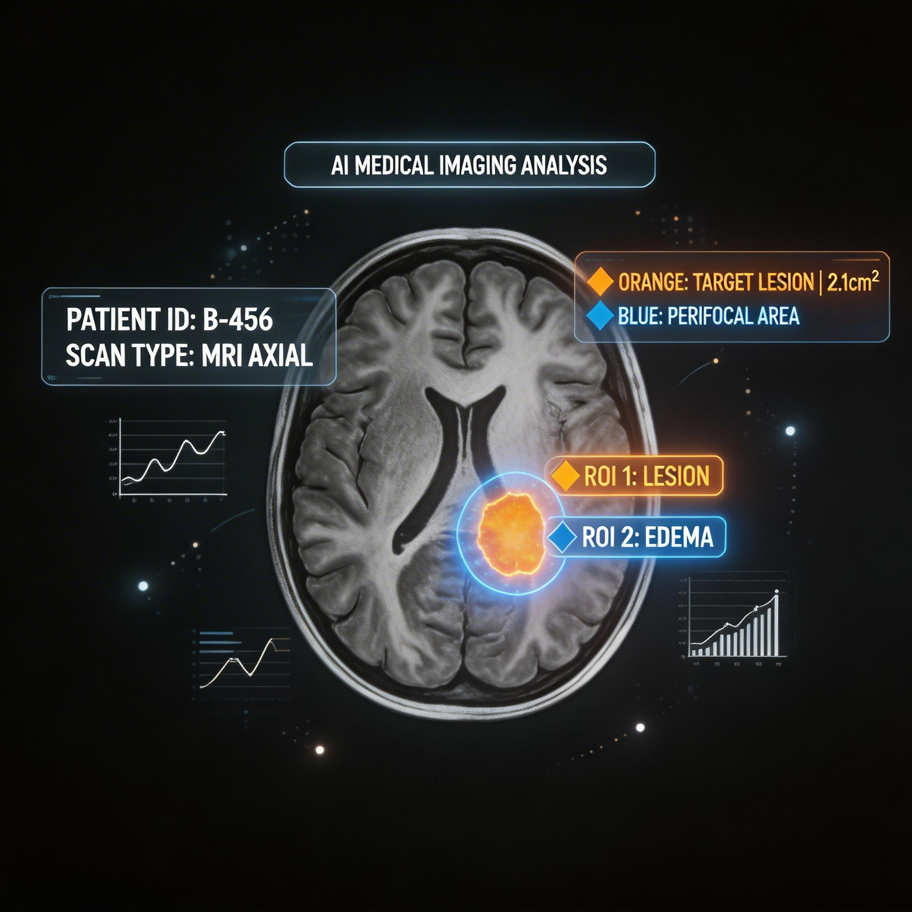






Medical AI System for MRI Image Analysis
Role of Computer Vision, Image Formation, and Application Relevance
Computer Vision
Image Formation
Clinical Applications
Presented by: K. V. Sai. Shanmukh 192424306
Notes:
Welcome. This presentation is about a Medical AI System for MRI Image Analysis, focusing on the role of computer vision, how MRI images are physically formed, and where these systems matter in real clinical practice. Over the next few minutes we will move from the basics of MRI and medical AI, through the computer vision pipeline and MRI image formation physics, into real disease-detection applications, the end-to-end system workflow, and finally the advantages and challenges of deploying such AI systems in hospitals.

Slide 2




Introduction
Understanding MRI and the role of Artificial Intelligence
Traditional vs. AI-Assisted Diagnosis
What is MRI?
A non-invasive imaging technique that uses magnetic fields and radio waves to produce detailed images of internal organs and tissues, especially soft tissue like the brain.
Traditional Diagnosis
Manual visual reading by radiologist
Slower, depends on experience
Subtle abnormalities may be missed
What is Medical AI?
Software systems that use machine learning and computer vision to analyze medical images, detect patterns, and support clinical decision-making.
VS
AI-Assisted Diagnosis
Automated pattern & anomaly detection
Fast, consistent, and scalable
Highlights subtle findings for review
Why AI in MRI Analysis?
MRI scans are complex and time-consuming to read manually. AI speeds up analysis, improves consistency, and flags subtle abnormalities a human eye may miss.
Medical AI System for MRI Image Analysis
2
Notes:
MRI, or Magnetic Resonance Imaging, is a non-invasive scanning technique that uses strong magnetic fields and radio waves to create detailed images of soft tissue, making it especially valuable for brain and spinal imaging. Medical AI refers to software that applies machine learning and computer vision to interpret these images automatically. We use AI in MRI analysis because manual reading is slow and dependent on radiologist experience, and subtle abnormalities can be missed. The comparison on the right shows that traditional diagnosis relies entirely on manual visual reading, while AI-assisted diagnosis adds automated, consistent, and fast pattern detection that supports the doctor rather than replacing them.

Slide 3





Role of Computer Vision
Computer vision transforms a raw MRI scan into a structured clinical insight
MRI Image
Image
Acquisition
Image
Preprocessing
Image
Segmentation
Feature
Extraction
AI
Classification
Disease
Detection
Raw scan received
Digital capture of
scan slices
Noise removal &
normalization
Isolating organs /
regions of interest
Identifying key
patterns & shapes
Model analyzes
features
Final diagnostic
output
Why Computer Vision Matters
Computer vision gives the AI system the ability to "see" and interpret an MRI scan the way a radiologist does — locating structures, measuring shapes, and recognizing patterns linked to disease, entirely from pixel data.
Research reference: Krolik et al., “MRI Brain Tumor Detection with Computer Vision,” arXiv:2510.10250 (2025) — reports CNN, ResNet, U-Net segmentation, and EfficientDet models improving brain tumor detection accuracy, matching this exact pipeline.
Medical AI System for MRI Image Analysis
3
Notes:
Computer vision is the branch of AI that allows a system to interpret visual data. In an MRI pipeline, the raw MRI image first goes through image acquisition, where the digital scan slices are captured. Preprocessing then removes noise and normalizes brightness and contrast. Segmentation isolates the organ or region of interest, such as the brain or a tumor boundary. Feature extraction identifies shapes, edges, and textures relevant to disease. The AI classification stage applies a trained model to these features, and finally the system outputs a disease detection result that supports the doctor's diagnosis. Each stage builds on the previous one to convert raw pixels into clinical insight. As a real-world reference, a 2025 arXiv study by Krolik and colleagues, titled MRI Brain Tumor Detection with Computer Vision, applied CNNs, ResNet, U-Net segmentation, and EfficientDet detection to this same style of pipeline and reported meaningful accuracy gains, reinforcing why each of these computer vision stages matters in practice.

Slide 4



Image Formation
How the physical MRI signal becomes a viewable image
1
2
3
4
Magnetic Field
Alignment
Radio Frequency
Pulse
Signal
Emission
Image
Reconstruction
A powerful magnetic field aligns the spin of hydrogen atoms (protons) in the body's water and fat molecules.
RF pulses are applied at a specific frequency, temporarily disturbing the aligned hydrogen atoms.
As atoms relax back into alignment, they emit faint radio signals that are picked up by receiver coils.
A computer processes the emitted signals using mathematical transforms to reconstruct a detailed MRI image.
Key Idea
MRI does not use radiation — it forms images purely from magnetic and radio-frequency interactions with hydrogen atoms in body tissue.
Medical AI System for MRI Image Analysis
4
Notes:
MRI image formation starts with a strong magnetic field that aligns the spin of hydrogen atoms present throughout the body's water and fat. Next, radio frequency pulses are applied at a precise frequency, which knocks these aligned atoms out of equilibrium. As the atoms relax back to their original alignment, they emit faint radio signals, which are captured by receiver coils placed around the patient. Finally, a computer applies mathematical reconstruction techniques, such as the Fourier transform, to convert these raw signals into the detailed cross-sectional images radiologists and AI systems analyze. Importantly, MRI uses no ionizing radiation, unlike X-ray or CT.

Slide 5






Application Relevance
Where Medical AI for MRI creates real clinical impact
Brain Tumor Detection
Stroke Detection
Alzheimer's Detection
Locates and outlines tumor boundaries for treatment planning.
Identifies affected brain regions quickly for urgent care.
Tracks brain tissue atrophy patterns over time.
Multiple Sclerosis Diagnosis
Orthopedic MRI Analysis
Cancer Detection
Detects lesions in brain and spinal cord tissue.
Assesses joint, ligament, and cartilage damage.
Supports early identification of tumors in soft tissue.
[1] Krolik et al., “MRI Brain Tumor Detection with Computer Vision,” arXiv:2510.10250 (2025) — CNN, ResNet, U-Net & EfficientDet models improved detection accuracy.
Medical AI System for MRI Image Analysis
5
Notes:
Medical AI for MRI is applied across many areas of diagnosis. In brain tumor detection, AI locates and outlines tumor boundaries to help plan surgery or radiation therapy — a 2025 arXiv study by Krolik and colleagues confirms that CNNs, ResNet, U-Net segmentation, and EfficientDet detection meaningfully improve brain tumor diagnostic accuracy. In stroke cases, rapid detection of affected brain regions is critical because time lost directly affects patient outcomes. For Alzheimer's disease, AI tracks patterns of brain tissue atrophy over time. For multiple sclerosis, the system detects lesions in the brain and spinal cord. In orthopedics, MRI AI assesses joint, ligament and cartilage damage. And across oncology, AI supports early detection of tumors in soft tissue, which is often the single biggest factor in successful treatment.

Slide 6


Complete Workflow
From patient scan to doctor's decision — the end-to-end AI pipeline
Patient
MRI
Scanner
MRI
Image
Pre-
processing
Segmen-
tation
Feature
Extraction
AI
Model
Disease
Prediction
Doctor's
Report
DATA ACQUISITION
COMPUTER VISION PROCESSING
AI DECISION SUPPORT
How it works, end to end
The patient is scanned by the MRI machine, producing a raw MRI image. Computer vision stages — preprocessing, segmentation, and feature extraction — clean and structure the image data. A trained AI model then analyzes these features to predict the presence and type of disease. The result is compiled into a report the doctor reviews to confirm diagnosis and plan treatment.
Medical AI System for MRI Image Analysis
6
Notes:
This slide shows the complete workflow from start to finish. It begins with the patient being scanned by the MRI scanner, producing a raw MRI image. This falls under the data acquisition phase. The image then moves through computer vision processing: preprocessing, segmentation, and feature extraction, which clean and structure the raw pixel data. In the AI decision support phase, the trained AI model analyzes these features to predict disease presence, and the result is compiled into a report for the doctor. The doctor always remains the final decision-maker, using the AI output as a supporting tool rather than a replacement.

Slide 7






Advantages & Challenges
Balancing the benefits of Medical AI against real-world constraints
Advantages
Challenges
Faster Diagnosis
Requires Large Datasets
Reduces the time needed to analyze complex scans.
Needs vast, well-labeled MRI data to train reliably.
High Accuracy
Detects subtle patterns with strong consistency.
High Computational Cost
Training and running models demands significant hardware.
Early Disease Detection
Flags abnormalities at earlier, more treatable stages.
Data Privacy Concerns
Patient scan data must be secured and handled ethically.
Reduced Human Error
Minimizes fatigue-related oversight in readings.
Cannot Replace Doctors
Decision Support for Doctors
Clinical judgment and patient context remain essential.
Acts as a second opinion, not a replacement.
Medical AI System for MRI Image Analysis
7
Notes:
Medical AI systems for MRI bring clear advantages: faster diagnosis, high accuracy in pattern detection, the ability to catch disease at earlier stages, reduced human error from fatigue, and strong decision support for doctors. However, real-world deployment faces genuine challenges. These systems require large, high-quality labeled datasets to train effectively, demand significant computational resources, raise data privacy concerns since patient scans are highly sensitive, and — most importantly — AI cannot replace the clinical judgment, experience, and patient context that a doctor provides. AI should be seen as a powerful assistant, not an autonomous decision-maker.

Slide 8
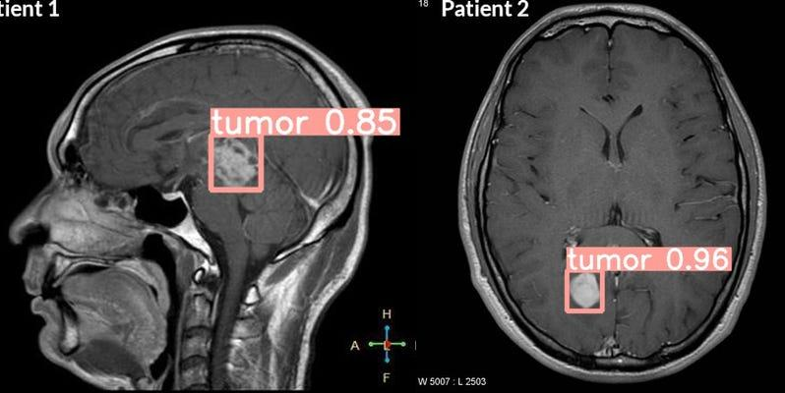
Conclusion
Computer vision transforms raw MRI scans into structured, analyzable data.
Understanding image formation clarifies exactly what the AI model is interpreting.
AI enables faster, more accurate, and more consistent MRI-based diagnosis.
Real applications span tumors, stroke, Alzheimer's, MS, orthopedics, and cancer.
AI supports doctors — it enhances clinical decisions, not replaces them.
“AI assists doctors in making better decisions, leading to improved patient care.”
Notes:
To conclude, computer vision transforms raw MRI scans into structured, analyzable data, while understanding image formation helps clarify exactly what the AI model is interpreting at the physical level. Together, these techniques enable faster, more accurate, and more consistent diagnosis across real applications including brain tumors, stroke, Alzheimer's disease, multiple sclerosis, orthopedic conditions, and cancer. The most important takeaway is that AI is designed to support doctors, not replace them — AI assists doctors in making better decisions, leading to improved patient care. Thank you.

Slide 9

Geotag photo

Slide 10


